Slide 1
CPT AppSwitch
MTK/Jingen Yu

Slide 2
CPT(Customer Performance Tool)
CPT
What is CPT
MTK CPT is a performance issue quick analyzing tool which could quickly distinguish issue caused by customer or by MTK platform. CPT integrates a lot of analysis experiences from MTK engineers, the aim is to improve work efficiency and save resources. CPT consists of 2 parts, they are Rapid Screening Tool (APP Switch) and Systrace Analysis Tool.
App Switch:
It is used to test launch time of applications in several different scenarios which contains pure environment, App switch by cold launch and App switch by hot launch and Camera memory test, these test cases can check the CPU high and memory low healthy management.
Systrace Analysis Tool:
It is used to analyze camera systrace and some log files produced by systrace record tool, such as camera launch, camera switch, take picture.
Where to Get CPT
MTK on-Line –> Tool -> search “CTP” and download it.
Run environment
Windows 7 environment is recommended, device with user load and root permission is better to get enough analysis info, otherwise there may be lack of some analysis info and can not do factory reset action to clean the device test environment.

Slide 3
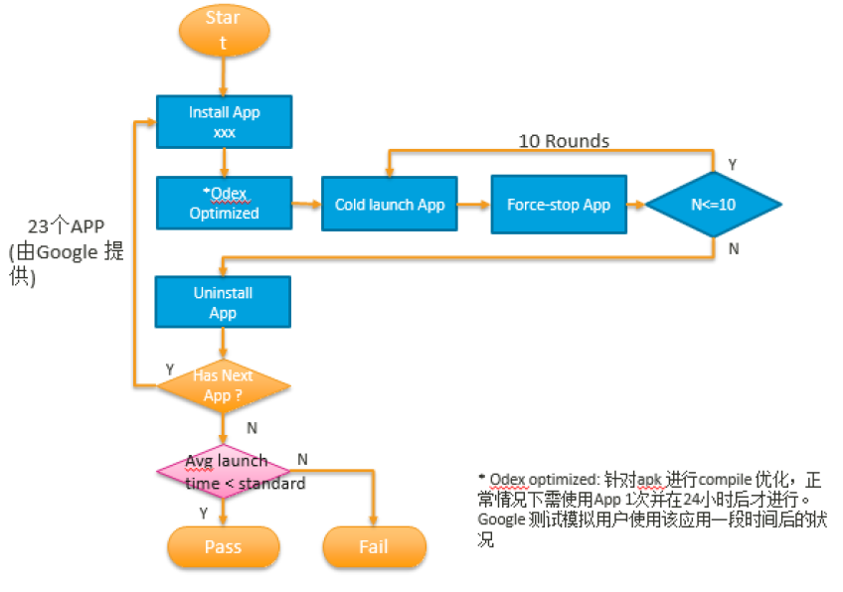
CPT(Customer Performance Tool)
App Switch
Test flow introduction: Google Performance Test

Slide 4
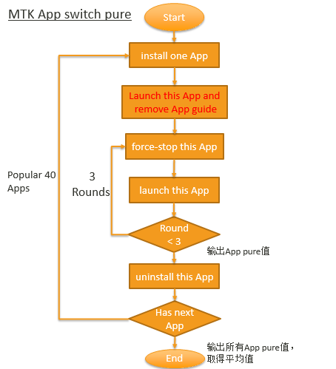
CPT(Customer Performance Tool)
App Switch
Test flow introduction:
App Switch Pure

Slide 5
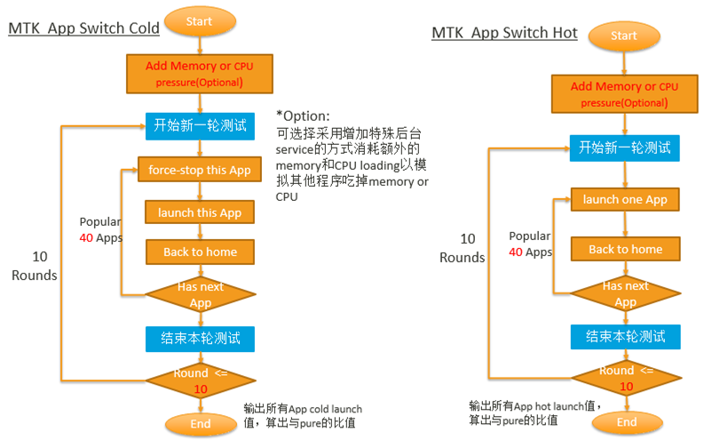
CPT(Customer Performance Tool)
App Switch
Test flow introduction: App Switch Cold and Hot test

Slide 6
CPT(Customer Performance Tool)
App Switch
App Switch Configuration: 《thrashing_check.ini》
[MemoryTest]
test=True // 是否要收集测试机的memory信息，建议root权限测试，否则抓到的memory信息很少
reboot=True // 测试前是否需要重启 . Reboot后进入idle状态，等5分钟后测试
[GooglePerformanceTest]
test=True // 是否要进行Google Performance APP launch，需要root权限，否测无法测试
apk_path=D:\***\google_performance_apk\apks // PC机上google Performance apk 存放位置
apk_config_path=D:\***\google_performance_apk\test_app_config // google Performance apk 的 package name 和 activity name
test_round=10 // 测试的次数
[AppSwitchTest]
test=True // 是否进行 APP Switch Cold test， 无root权限也可以测试
apk_path=D:\****\AppSwitchTest\testapk2 // PC机上需要测试的 APP Switch Cold apk 存放位置
package_config_path= // 需要测试的built-in APK的 packageName/launchActivityName
test_round=10 // 测试的轮数
debug_mode=False // 是否要debug 单步测试
add_pure_test=True // 是否要做 pure test
pure_test_round=3 // pure test 次数
add_cpu_stress=False // 是否要添加 CPU 压力
add_memory_stress=False // 是否要添加 memory 压力
systrace_on=False // 是否要抓 trace
memory_dump=False // 是否要抓 memory 占用信息
thermal_check=True // 是否要抓 温度

Slide 7
CPT(Customer Performance Tool)
App Switch
App Switch Configuration: 《thrashing_check.ini》
[AppSwitchTestHot]
test=True // 是否进行 APP Switch Hot test，无root权限也可以测试
factory_reset=True // 测试前是否要做恢复出厂设置，此项为Ture必须要userdebug版本
apk_path=D:\******\AppSwitchTest\testapk2 // PC机上需要测试的 APP Switch Hot apk 存放位置
package_config_path= // 需要测试的built-in APK的 packageName/launchActivityName
test_round=10 // 测试的轮数
debug_mode=False // 是否要debug 单步测试
add_pure_test=True // pure test 次数
pure_test_round=3 // pure test 次数
add_cpu_stress=False // 是否要添加 CPU 压力
add_memory_stress=False // 是否要添加 memory 压力
systrace_on=False // 是否要抓 trace
memory_dump=False // 是否要抓 memory 占用信息
thermal_check=True // 是否要抓 温度
[CameraMemoryTest]
test=True // 是否进行Camera Memory Test, 建议root权限测试，否则抓到的memory信息很少
scenario=stay_by,preview,take_picture // Camera 测试的场景
test_time=10 // test 次数
camera_name=camera
camera_package= // camera apk 的 packageName/launchActivityName

Slide 8
CPT(Customer Performance Tool)
App Switch
App Switch Configuration: 《stress.ini》
主要配置 memory加压和CPU加压
[MemoryStress]
service=2 ; service count
// memory 加压的thread数目
memory=1000 ; total memory need been eat, unit is M
// memroy加压的 thread 允许占的total memory
[CpuStress]
service=1
// CPU加压的thread 数目
// 如果 add_cpu_stress=False && add_memory_stress=False，那么《 stress.ini 》文件不起作用

Slide 9
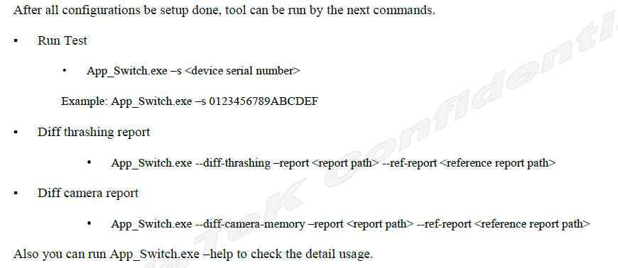
CPT(Customer Performance Tool)
App Switch
Test: cd the tool path

Slide 10
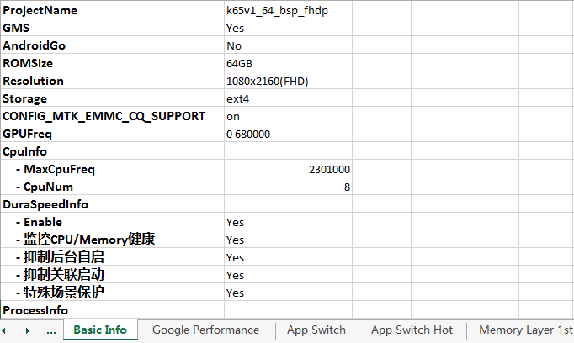
CPT(Customer Performance Tool)
App Switch
App Switch 生成的文件: 《thrashing_check.xlsx》
Device basic informations

Slide 11
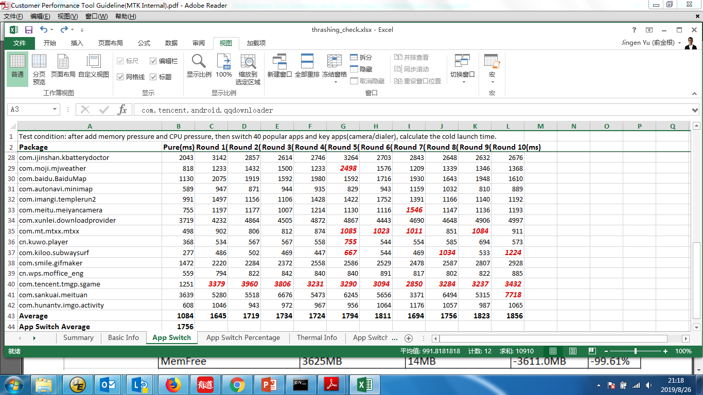
CPT(Customer Performance Tool)
App Switch
App Switch 生成的文件: 《thrashing_check.xlsx》
App Switch Cold data，launch数据相当pure环境衰减达2倍，测标红加粗:
如果一列数据中，连续出现5个红色，测表示后台管控不够激进。

Slide 12
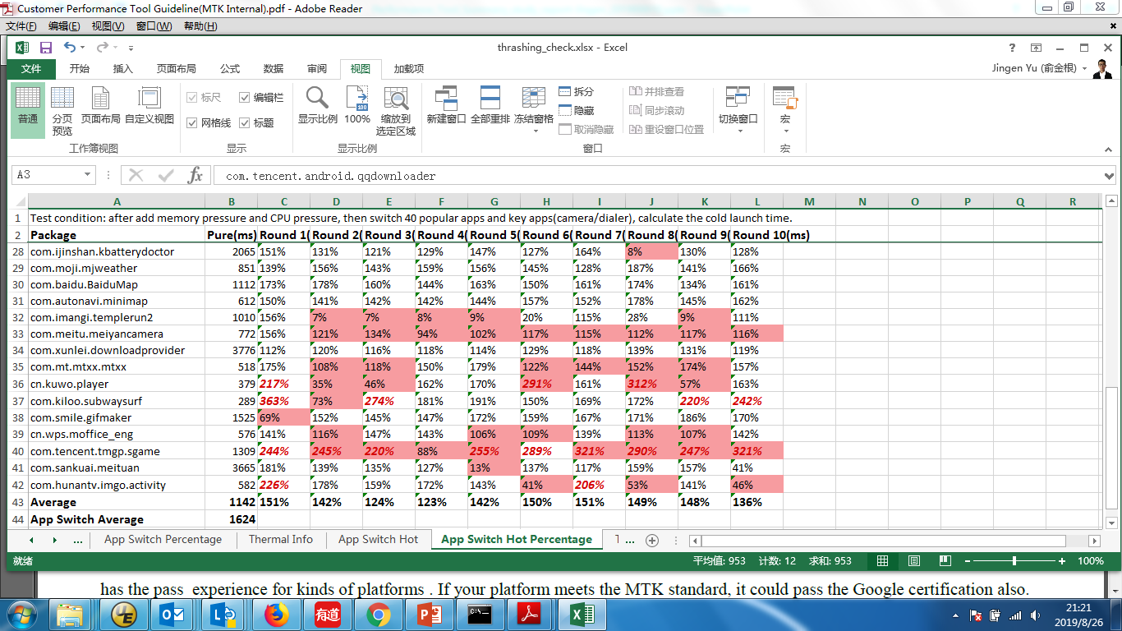
CPT(Customer Performance Tool)
App Switch
App Switch 生成的文件: 《thrashing_check.xlsx》
App Switch Hot data， launch数据相当pure环境衰减达2倍，测标红加粗:
如果是真正的 Hot launch，底色加深。

Slide 13
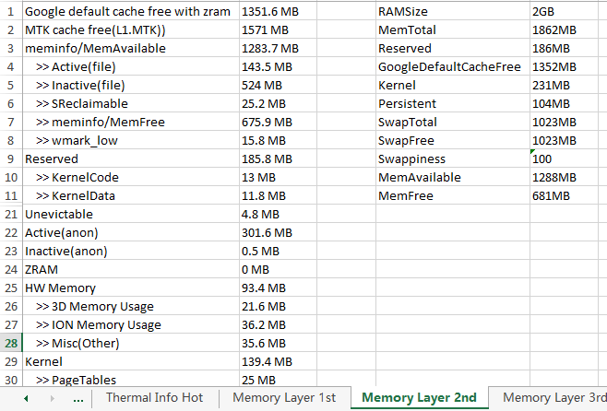
CPT(Customer Performance Tool)
App Switch
App Switch 生成的文件: 《thrashing_check.xlsx》
Memory data:

Slide 14
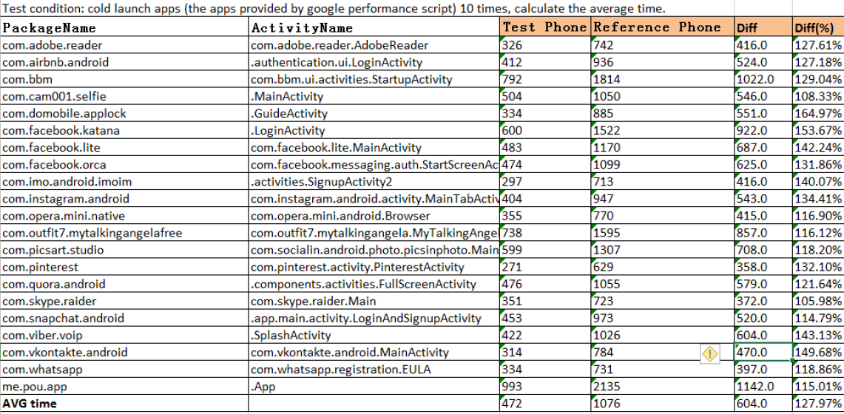
CPT(Customer Performance Tool)
App Switch
App Switch 生成的文件: 《thrashing_check.xlsx》
App_Switch.exe --diff-thrashing 比较两份测试结果: Google performance launch time

Slide 15
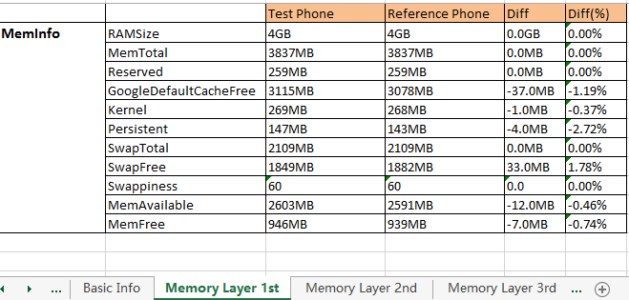
CPT(Customer Performance Tool)
App Switch
App Switch 生成的文件: 《thrashing_check.xlsx》
App_Switch.exe --diff-thrashing 比较两份测试结果: Memory Layer

Slide 16
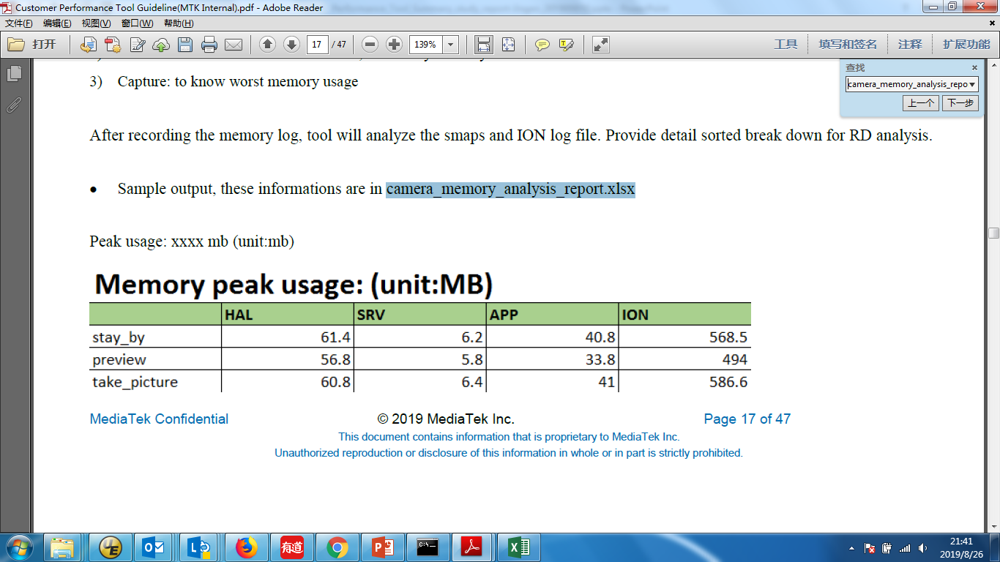
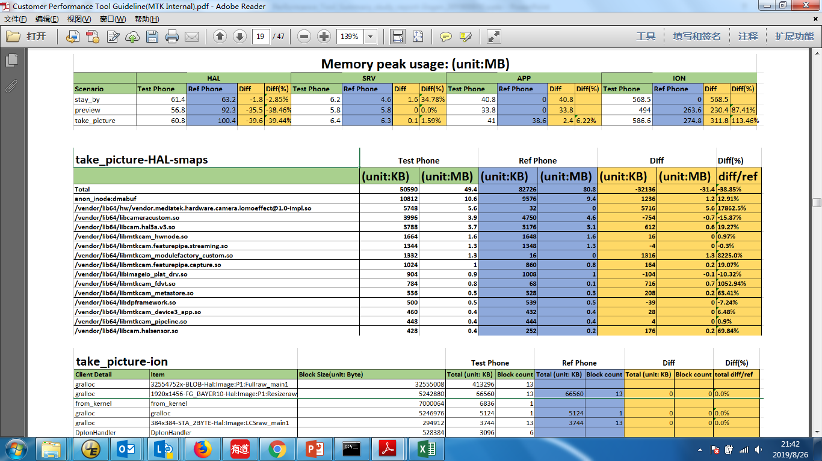
CPT(Customer Performance Tool)
App Switch
App Switch 生成的文件: 《camera_memory_analysis_report.xlsx》

Slide 17
CPT(Customer Performance Tool)
App Switch
Quick Start steps
1) Download & unzip tool CPT.zip to X:xxx\CPT\
2) Download & unzip google_performance_apk.zip and config files to
X:xxx\google_performance\
3) Download & unzip top_40_apk.zip to X:xxx\top_40_apk
4) Modify the configure file “thrashing_check.ini”
5) Run command: X:xxx\CPT\App_Switch\App_Switch.exe –s <device serial number>
6) Check the report file in output path:
X:xxx\CPT\App_Switch\<device serial number>
7) Compare two output table
App_Switch.exe --diff-thrashing --report .\out\thrashing_check1.xlsx --ref-report .\out\thrashing_check2.xlsx
There will generate <cpt_report.xlsx> in .\out\ folder

Slide 18
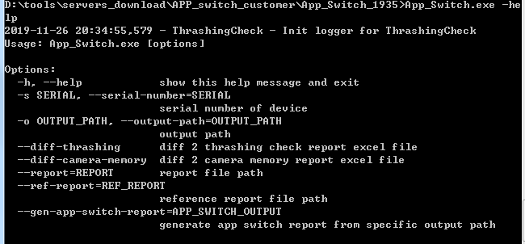
CPT(Customer Performance Tool)
App Switch
Quick Start steps
8) App_Switch.exe [options]

Slide 19
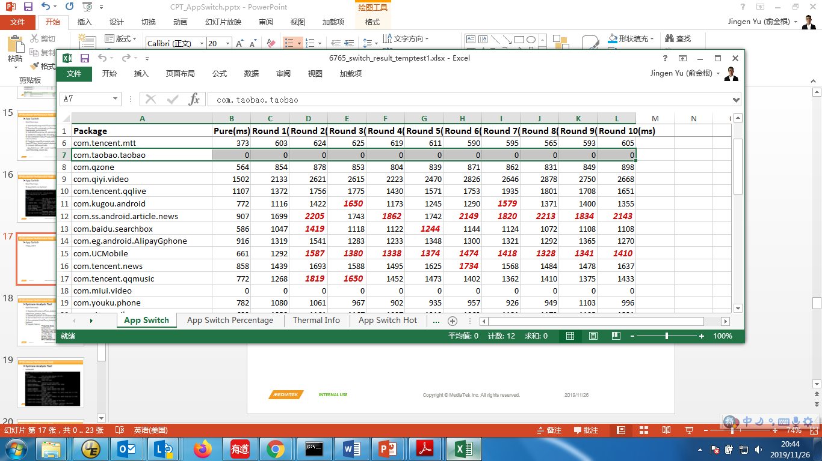
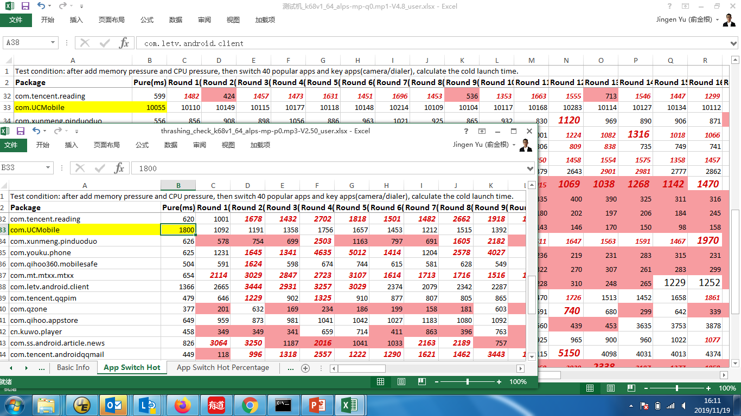
CPT(Customer Performance Tool)
App Switch
If App_Switch data is 0 or very large, please check the app version, is it too old?

Slide 20
CPT(Customer Performance Tool)
Systrace Analysis Tool
Quick Start steps
1) Download & unzip tool Trace_Analysis_Tool_wxxxx_x.zip to
X:xxx\Trace_Analysis_Tool\
2) Download systrace+ from MTK-on-line
3) Run test local test case and record the systrace by trace record tool
4) Run command:
X:xxx\Trace_Analysis_Tool\Trace_Analysis_Tool.exe [options]
5) Check the report in output path: X:xxx\CPT\Trace_Analysis_Tool\output
6) Support Pattern:
a. Resolution Size
b. Camera Latency
c. Task Loading:
OpenDex time check
Kswapd loading
JIT time check
Logd loading
cameraserver/camerahalserver

Slide 21
CPT(Customer Performance Tool)
Systrace Analysis Tool
Parse commands

Slide 22
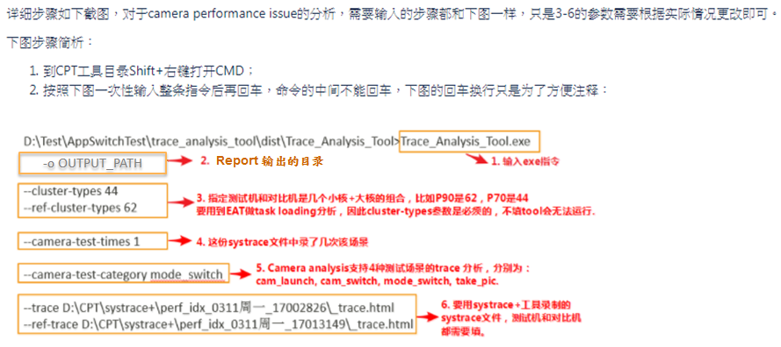
CPT(Customer Performance Tool)
Systrace Analysis Tool
使用方法
附上命令： Trace_Analysis_Tool.exe --cluster-types 62 --ref-cluster-types 62 --camera-test-times 1 --camera-test-category cam_launch --trace E:\CPT_and_systrace+\systrace+_v\perf_idx_20190528_19553222\camera_trace.html --ref-trace E:\CPT_and_systrace+\systrace+_v\perf_idx_20190528_19553222\camera_trace.html

Slide 23
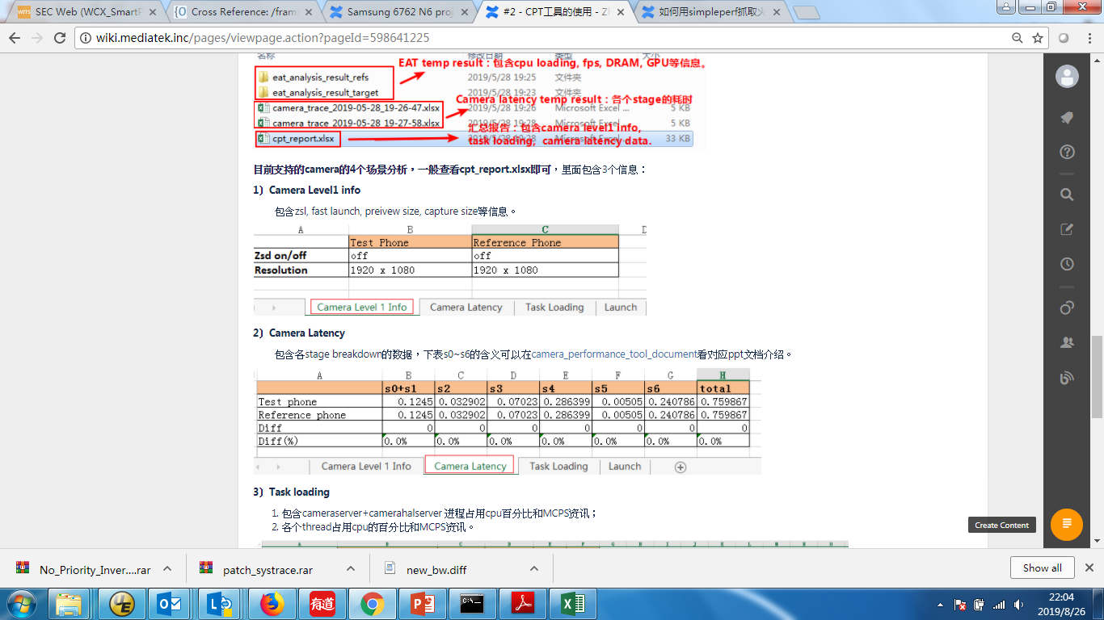
CPT(Customer Performance Tool)
Systrace Analysis Tool
生成的文件

